Slide 1

Welcome to Spring 3.0 Chapter 6B Spring Advance - JMS

Slide 2
Chapter 6B – Spring JMS
Spring JMS Integration | What is JMS?
 | JMS vs. EMAIL
 | JMS Application
 | JMS Components
 | MOM Service Providers
 | Messaging Models(PTP & Pub/Sub)
 | JMS API Programming Model
 | Message Consumption Types
 | Spring JMS integration & Code Samples
 | JMS Message Types, JMS Features, JNDI ,SOAP & Misc. Topics

Slide 3
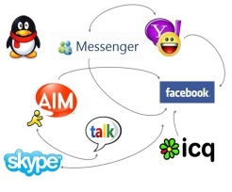
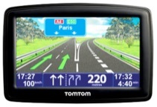
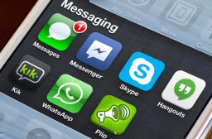





What is Message and Messaging?
What is Message?
A message has been described in various ways by different specification. However it is an entity of the communication. It is bytes of data that is meaningful between the applications which use it. Messages are used to transfer information from one application to other ones which may or may not run in same platforms.
What is Messaging?
Messaging is communication between system components or different applications (in a distributed environment) which are loosely coupled unlike its peers like TCP sockets, CORBA or RMI.
Advantage of messaging : The advantages of java messaging include the ability to integrate different platforms, reduce system bottlenecks, increase scalability and reliability of message delivery.

Slide 4
What is JMS?
The Java Message Service (JMS) is a Java Message Oriented Middleware (MOM) API for sending messages between two or more clients. JMS is a part of the Java Enterprise Edition.
A specification that describes a common way for Java programs to create, send, receive and read distributed enterprise messages.
loosely coupled communication
Asynchronous messaging
Reliable delivery
A message is guaranteed to be delivered once and only once.

Slide 5
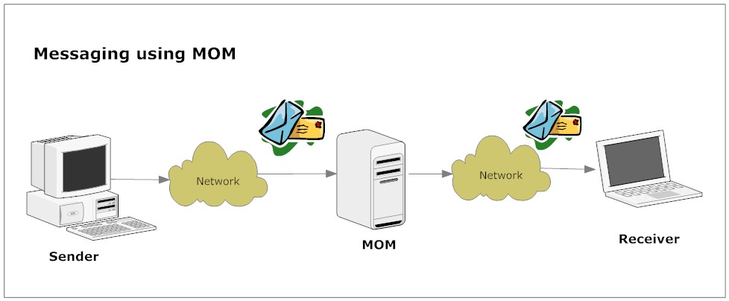
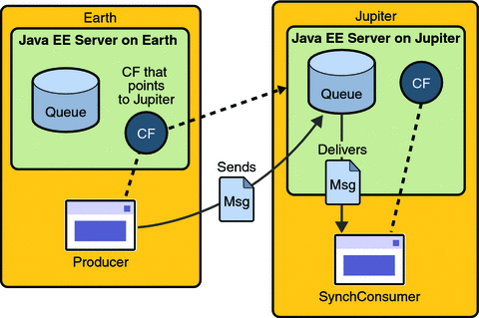
JMS Application
MQ
(ActiveMQ , IBM MQ)
Sender
(.NET/Mainframe based app)
Receiver
(Java/Spring based app)

Slide 6
JMS vs. Java Mail?
eMail | JMS
Java Mail is an API for sending emails, emails with attachment, reading emails, etc. | The JMS is the Java Messaging Service which is capable of exchanging messages between applications.
Mainly human to human information exchange. | Inter and Intra Company “Application/Human to Application/Human Messaging”. e.g. chat or stock ticker
Delivery can be duplicate or nor guaranteed. | JMS is more like a database - the messages (can be configured) to be drained if and only if the recipient system reads it. In other words the delivery can be guaranteed.
Its not a big deal to get multiple copies of an email (which u may get if u loose a connection with an email server over POP for example) | It would be a major disaster to get 2 copies of the "remove $1000 from my bank account" or “sell 50% of my shares ” messages.
Email is designed for connectivity on the web. | JMS has a bunch of different qualities of service (durable v non-durable, queue v topic) designed for very high performance messaging with low latency together with reliability avoiding duplicates and message loss.
The only correlation is that both technologies are intended for transmitting "messages". The main difference between these two is their history and design criteria. JMS is for sending messages between application components, and the Java Mail API is for sending an actual email.
Notes:
Other principals: device, other system
These concepts are common, and not at all specific to Spring Security

Slide 7
JMS Components
JMS Provider : The messaging system (MOM) that implements JMS in addition to other administrative and control functionality required of a full-featured messaging product(IBM MQ, Active MQ). A message broker or agent(like a post office/postman).
JMS clients: Java applications that produce or receive messages.
JMS Producer / Publisher: A JMS client that creates and sends messages.
JMS Consumer/ Subscriber: A JMS client that receives messages.
JMS Application : The system composed of many JMS clients and typically one JMS provider.
Notes:
Other principals: device, other system
These concepts are common, and not at all specific to Spring Security

Slide 8
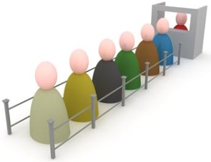
JMS Application
JMS Application
Producer
JMS Provider(e.g. Active MQ)
JMS Client
JMS Client
JMS Client
Producer/Consumer
Consumer

Slide 9
MOM Service Providers
MOM Service Provider Products | Company
Weblogic | Oracle
MQSeries | IBM
JBOSSMQ | JBOSS
SoniqMQ | Progress
TIBCO EMS | TIBCO
ActiveMQ | Apache

Slide 10
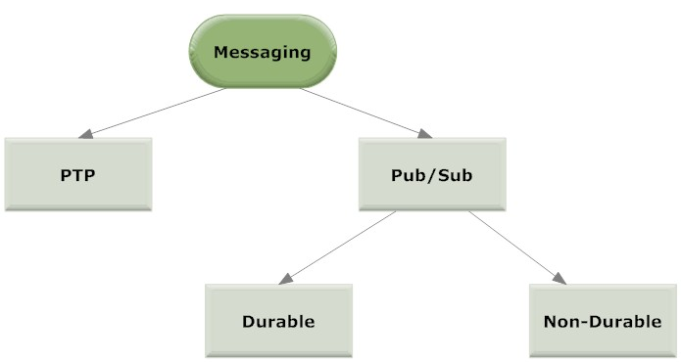
Messaging Models
Publish-Subscribe systems
uses a “topic” to send and receive messages
each message has multiple consumers
Point-to-Point (PTP)
built around the concept of message queues
each message has only one consumer

Slide 11
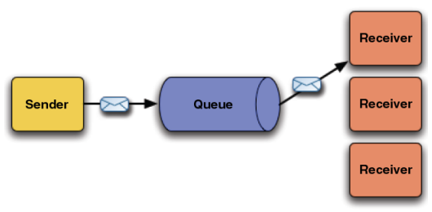
Point to Point(PTP)
Notes:
Other principals: device, other system
These concepts are common, and not at all specific to Spring Security

Slide 12
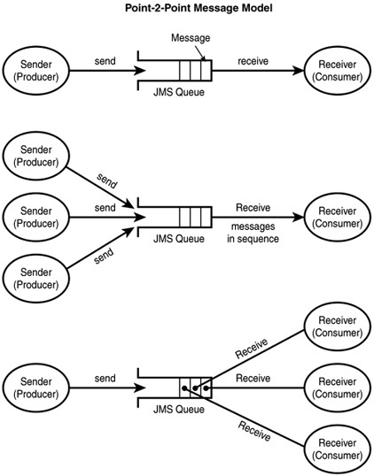
Point to Point(PTP)
A queue might have
more than one sender
& more than one receiver,
but only one receiver may consume each message

Slide 13
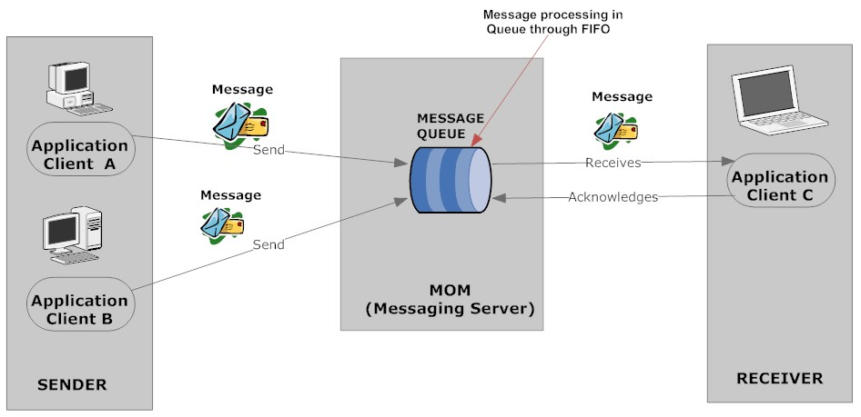

Point to Point(PTP)

Slide 14
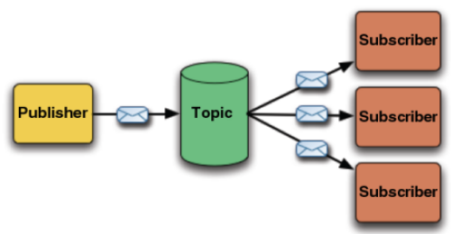
Publish & Subscribe(Pub/Sub)

Slide 15
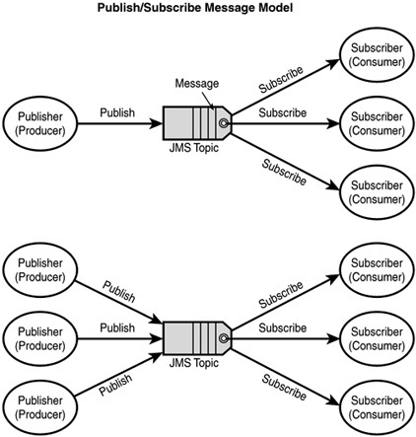
Publish & Subscribe(Pub/Sub)
Each message published to a topic
is broadcast to all the clients that subscribe to this topic.
Notes:
Other principals: device, other system
These concepts are common, and not at all specific to Spring Security

Slide 16
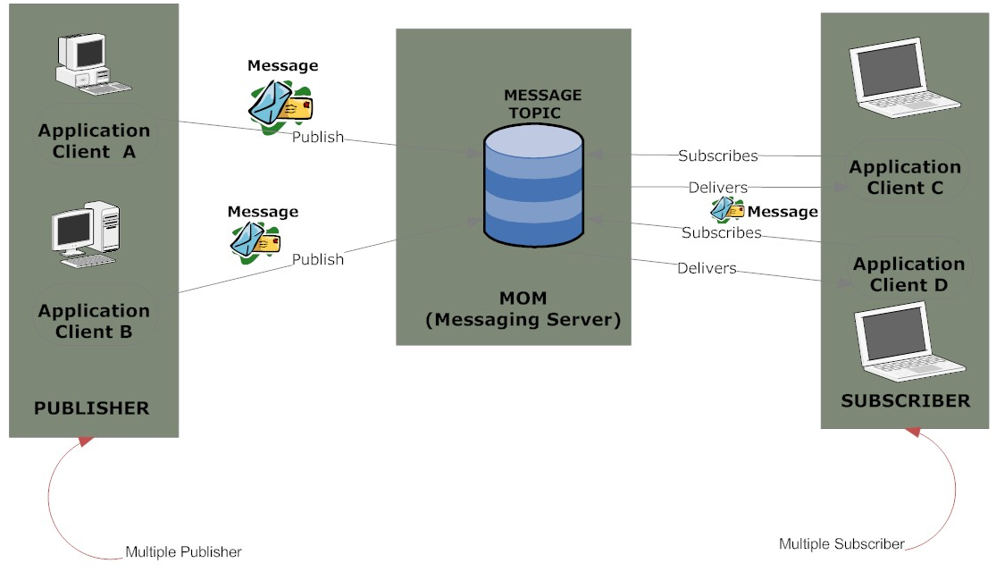
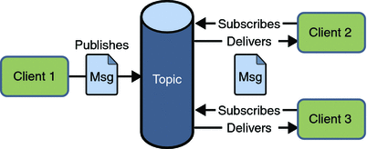
Publish & Subscribe(Pub/Sub)

Slide 17
PTP vs. Pub/Sub
Point to Point | Publisher / Subscriber
Each message has only one consumer | Each message can have multiple consumers.
Messages are first sent to the destination named Queue. | Messages are first published in the destination called Topic.
A sender and a receiver of a message have no timing dependencies. The receiver can fetch the message whether or not it was running when the client sent the message. | Publishers and subscribers have a timing dependency. A client that subscribes to a topic can consume only messages published after the client has created a subscription, and the subscriber must continue to be active in order for it to consume messages.
The receiver acknowledges the successful processing of a message. | Does not provide acknowledgement

Slide 18
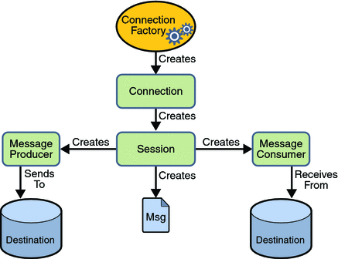
The JMS API Programming Model
ConnectionFactory -> Connection -> Session -> Message Producer/Consumer -> Send/Receive

Slide 19
The JMS API Programming Model – JMS Client
InitialContext jndiContext=new InitialContext();
//look up for the connection factory
ConnectionFactory cf=jndiContext.lookup(connectionfactoryname);
//create a connection
Connection connection=cf.createConnection();
//create a session
Session session=connection.createSession(false,Session.AUTO_ACKNOWLEDGE);
//create a destination object
Destination dest1=(Queue) jndiContext.lookup(“/jms/myQueue”); //for PointToPoint
Destination dest2=(Topic)jndiContext.lookup(“/jms/myTopic”); //for publish-subscribe
ConnectionFactory -> Connection -> Session -> MessageProducer/Consumer -> Send/Receive

Slide 20
The JMS API Programming Model - Producer
Setup connection and create a session
Creating producer
MessageProducer producer=session.createProducer(dest1);
Send a message
Message m=session.createTextMessage();
m.setText(“just another message”);
producer.send(m);
Closing the connection
connection.close();
ConnectionFactory -> Connection -> Session -> MessageProducer/Consumer -> Send/Receive

Slide 21
The JMS API Programming Model – Consumer Synchronous
Setup connection and create a session
Creating consumer
MessageConsumer consumer=session.createConsumer(dest1);
Start receiving messages
connection.start();
Message m=consumer.receive();
Synchronous messaging involves a client that waits for the server to respond to a message. So if one end is down the entire communication will fail.
Asynchronous messaging involves a client that does not wait for a message from the server. An event is used to trigger a message from a server. So even if the client is down , the messaging will complete successfully.
Notes:
Synchronous messaging involves a client that waits for the server to respond to a message. So if one end is down the entire communication will fail. Asynchronous messaging involves a client that does not wait for a message from the server. An event is used to trigger a message from a server. So even if the client is down , the messaging will complete successfully.

Slide 22
The JMS API Programming Model – Consumer Asynchronous
Setup the connection, create a session
Create consumer
Registering the listener
MessageListener listener=new myListener();
consumer.setMessageListener(listener);
myListener should have onMessage()
public void onMessage(Message msg){
//read the message and do computation
}
ConnectionFactory -> Connection -> Session -> MessageProducer/Consumer -> Send/Receive

Slide 23
JMS integration framework
Spring provides a JMS integration framework that simplifies the use of the JMS API much like Spring's integration does for the JDBC API.
JMS can be roughly divided into two areas of functionality, namely the production and consumption of messages.
The JmsTemplate class is used for message production and synchronous message reception.
For asynchronous reception similar to Java EE's message-driven bean(MDB) style, Spring provides a number of message listener containers that are used to create Message-Driven POJOs (MDPs).

Slide 24
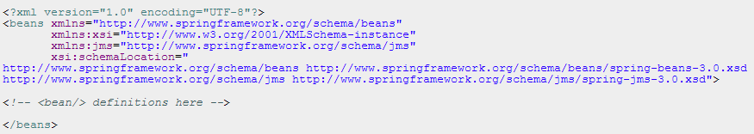
JMS integration framework
http://www.apache.org/dyn/closer.cgi?path=/activemq/apache-activemq/5.4.3/apache-activemq-5.4.3-bin.zip

Slide 25
DEMO
Active MQ Demo
Core-JMS-Asynchronous
Spring-JMS0-SendOnly
Spring-JMS-CHAT

Slide 26
Message Consumption
Messaging products are inherently asynchronous: There is no fundamental timing dependency between the production and the consumption of a message. However, the JMS specification uses this term in a more precise sense. Messages can be consumed in either of two ways:
Synchronously: A subscriber or a receiver explicitly fetches the message from the destination by calling the receive method. The receive method can block until a message arrives or can time out if a message does not arrive within a specified time limit.
Asynchronously: A client can register a message listener with a consumer. A message listener is similar to an event listener. Whenever a message arrives at the destination, the JMS provider delivers the message by calling the listener’s onMessage() method, which acts on the contents of the message.
While JMS is typically associated with asynchronous processing, it is possible to consume messages synchronously.
Notes:
Synchronous messaging involves a client that waits for the server to respond to a message. So if one end is down the entire communication will fail. Asynchronous messaging involves a client that does not wait for a message from the server. An event is used to trigger a message from a server. So even if the client is down , the messaging will complete successfully.

Slide 27
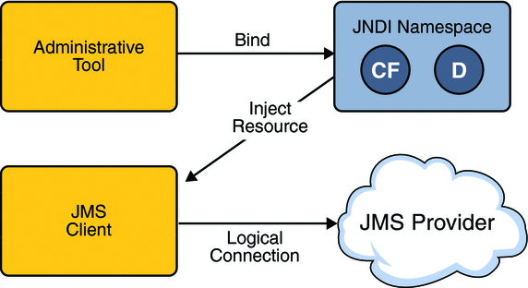
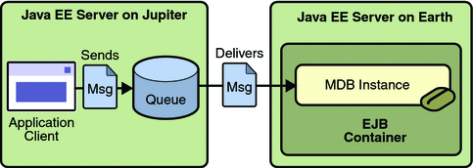
JNDI

Slide 28
JNDI

Slide 29
JNDI

Slide 30
JNDI

